Slide 1

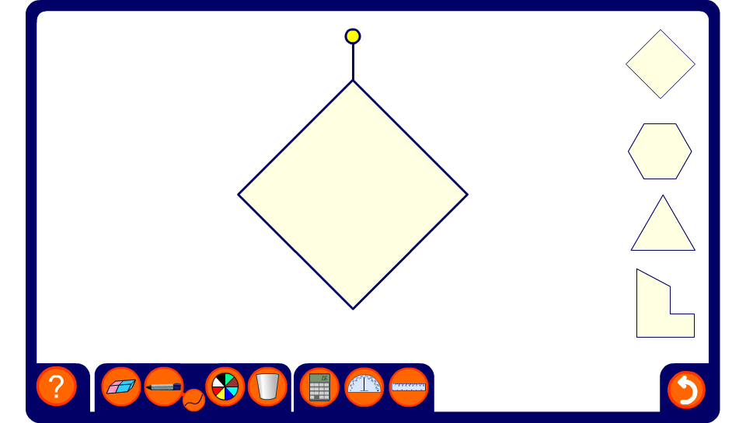


The locus of points from a given shape
Notes:
Discuss the fact that for each shape the locus is parallel to the edges and rounded at the corners.
Ask pupils to use the pen tool to sketch what they think the path will look like before starting the animation.
Again, we can think of these loci as a combination of the locus of points that are a fixed distance from a line (around the edges) and the locus of points that are a fixed distance from a point (around the corners).

